Slide 1



A320 FFS
Maintenance Technicians
Training Course
Prepared By: Mohamed Sakr
Safety
Thales Training & Simulation
Notes:
1 Overview Physical
9-Aug-99
Robbie Young Instructor Notes TTSL Prod Training Department

Slide 2
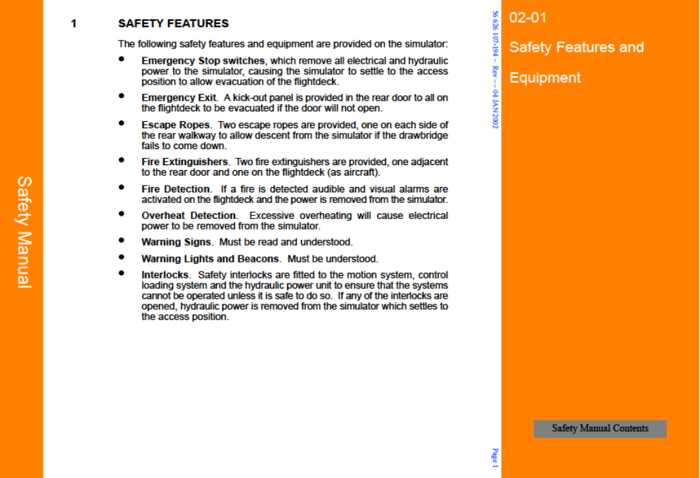

Slide 3
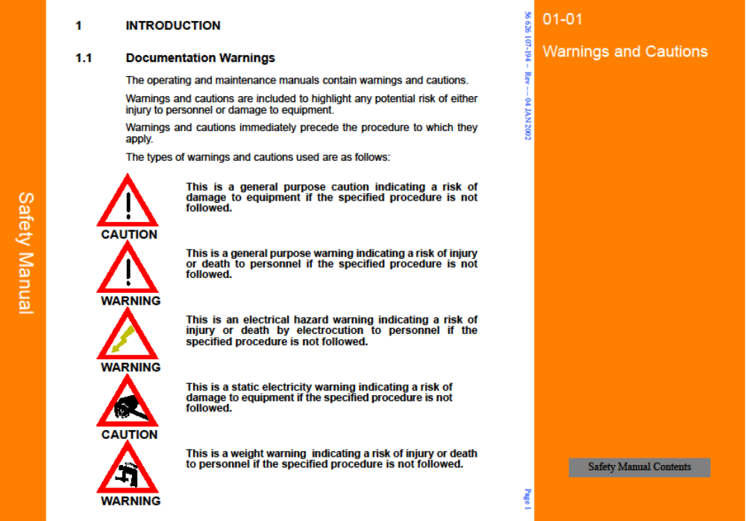
Notes:
1 Overview Physical
9-Aug-99
Robbie Young Instructor Notes TTSL Prod Training Department

Slide 4
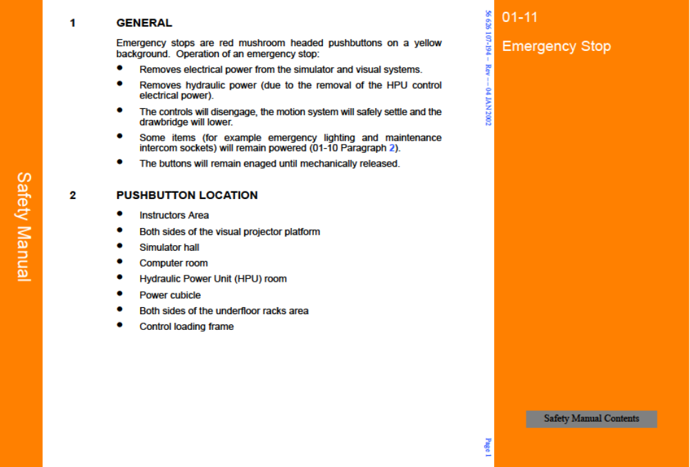

Slide 5
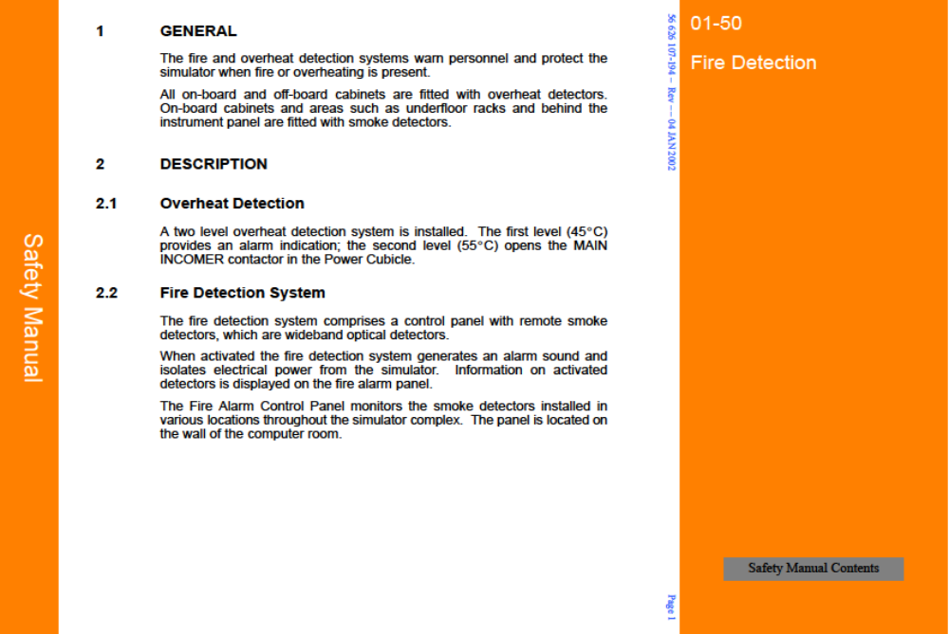

Slide 6
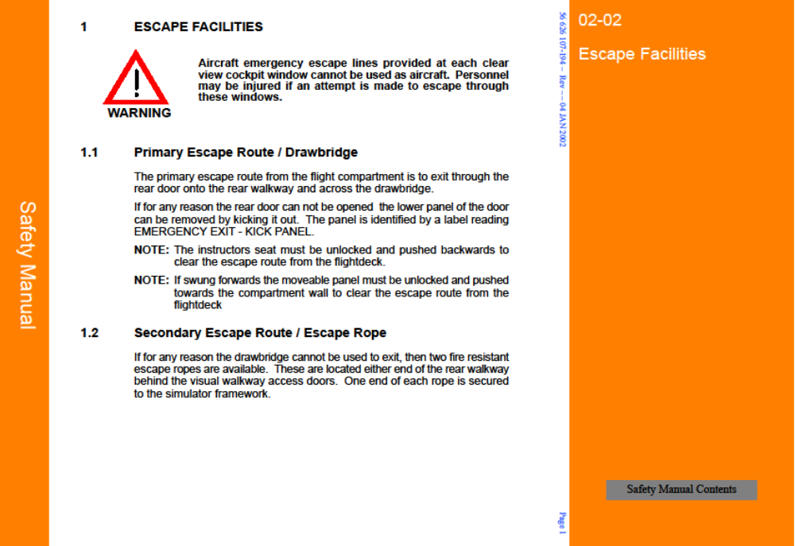

Slide 7
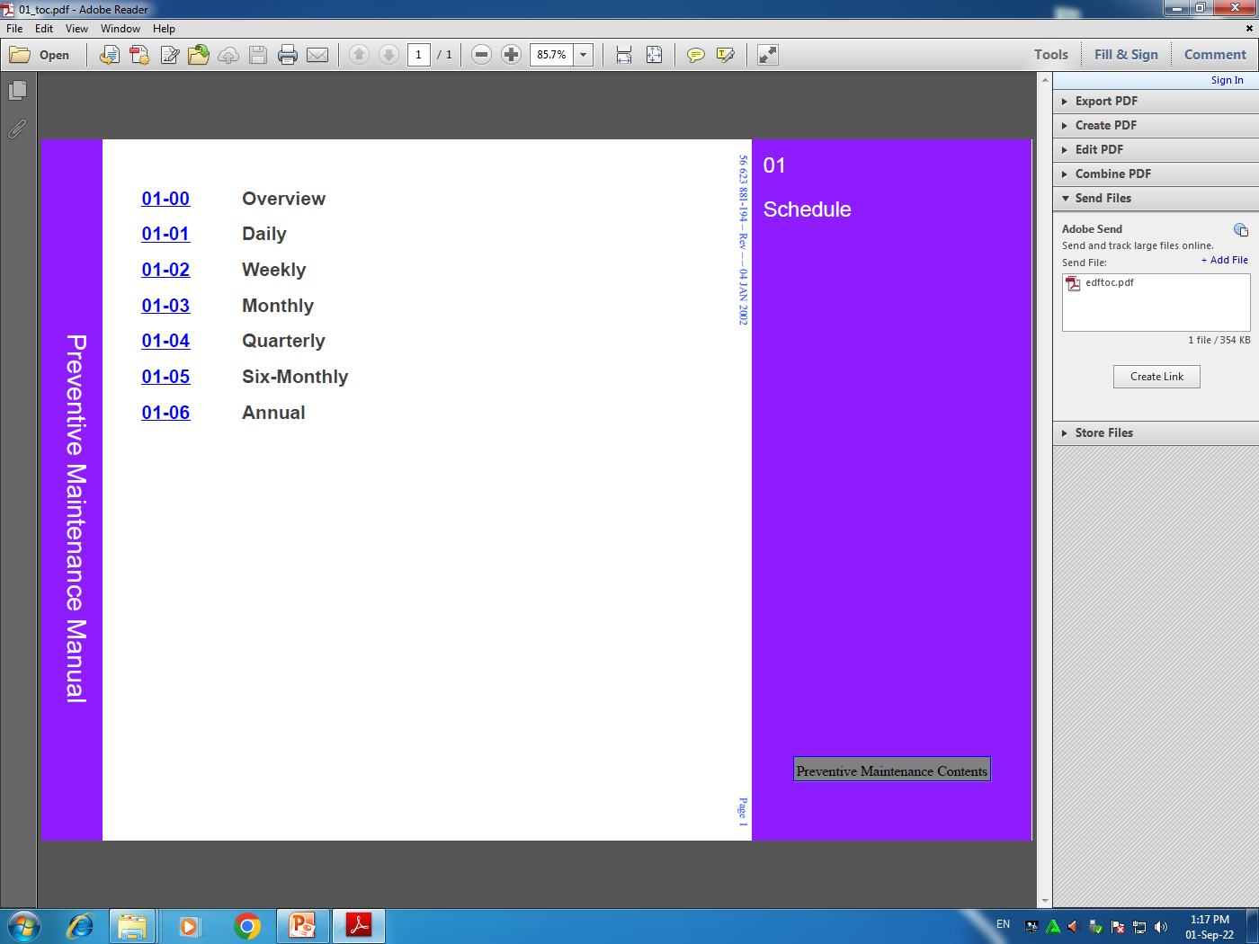
Preventive maintenance tasks are performed to maintain the simulator in good working order.
These tasks are scheduled to be performed at specified
periods (daily, weekly, monthly, quarterly, six monthly and annually).
Preventive Maintenance Schedule

Slide 8


References : THALES STD simulator Manufacture manual .
?
Please Feel free to Ask
Practical

